Slide 1
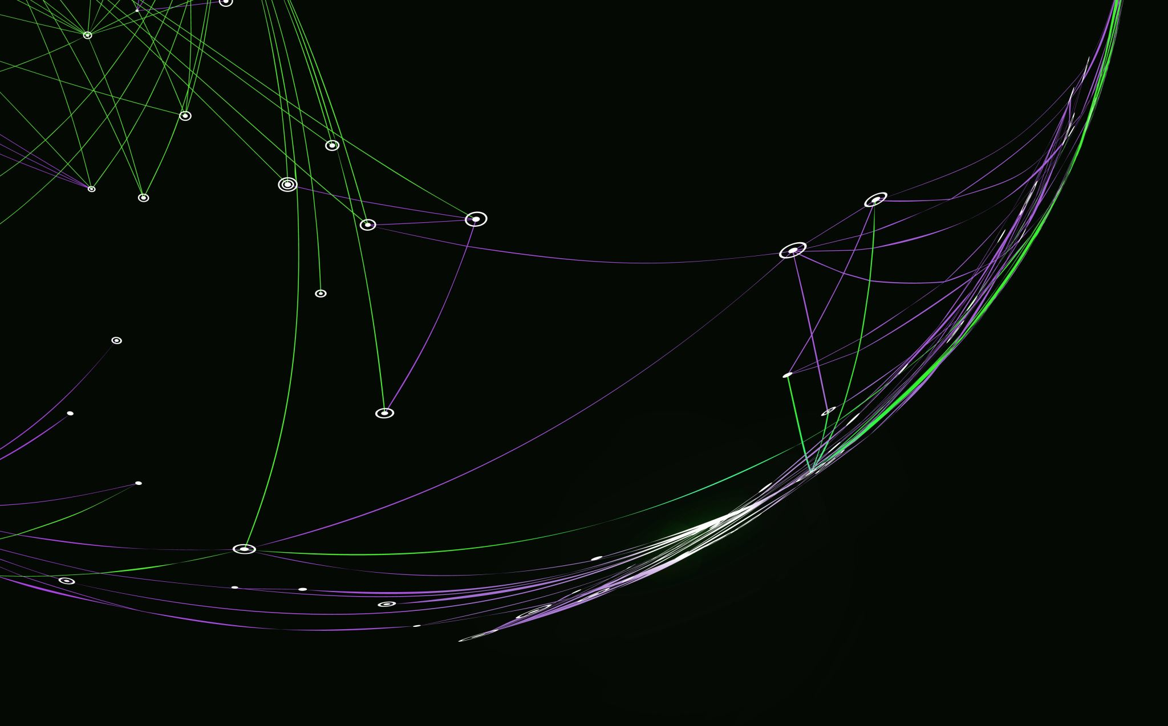

Quantum Low Density Parity Check (QLDPC) Code
Professor Luca Barletta
Moein Taherinezhad
July – 2024

Slide 2

Introduction
Quantum Low-Density Parity-Check Codes
Correct error using measurements that are low-weight (involve few qubits)
Notes:
And at a very high level, quantum LDPC codes or QLDPC codes are simply a way of correcting errors on quantum states, using measurements of low-weight or measurements that involve few qubits.
So we're going to be having some encoding of a quantum state and somehow by processing the measurement outcomes, we'll be able to recover our original code state.
So to give an overview of the history of these,

Slide 3

Overview of History
For many years toric/surface code was close to state-of-the-art
Recently, more interest in QLDPC codes based on product of classical codes & expanders graphs:
Asymptotically optimal in certain respect
Potential for good finite-size performance
Notes:
for many years, the toric code or the surface code, which I'll be describing in a bit, was close to state of the art, both in terms of some theoretical parameters as well as in terms of practical performance, at least in numerical simulations.
And yet recently, in the past maybe five to 10 years, there's been much more interest in QLDPC codes that are based on classical codes and products of classical codes and expander graphs:
1- These newer codes are interesting because, in certain respects, they can give asymptotically optimal performance.
2- And they also seem to have the potential to yield good finite-size performance even in near-term devices.

Slide 4
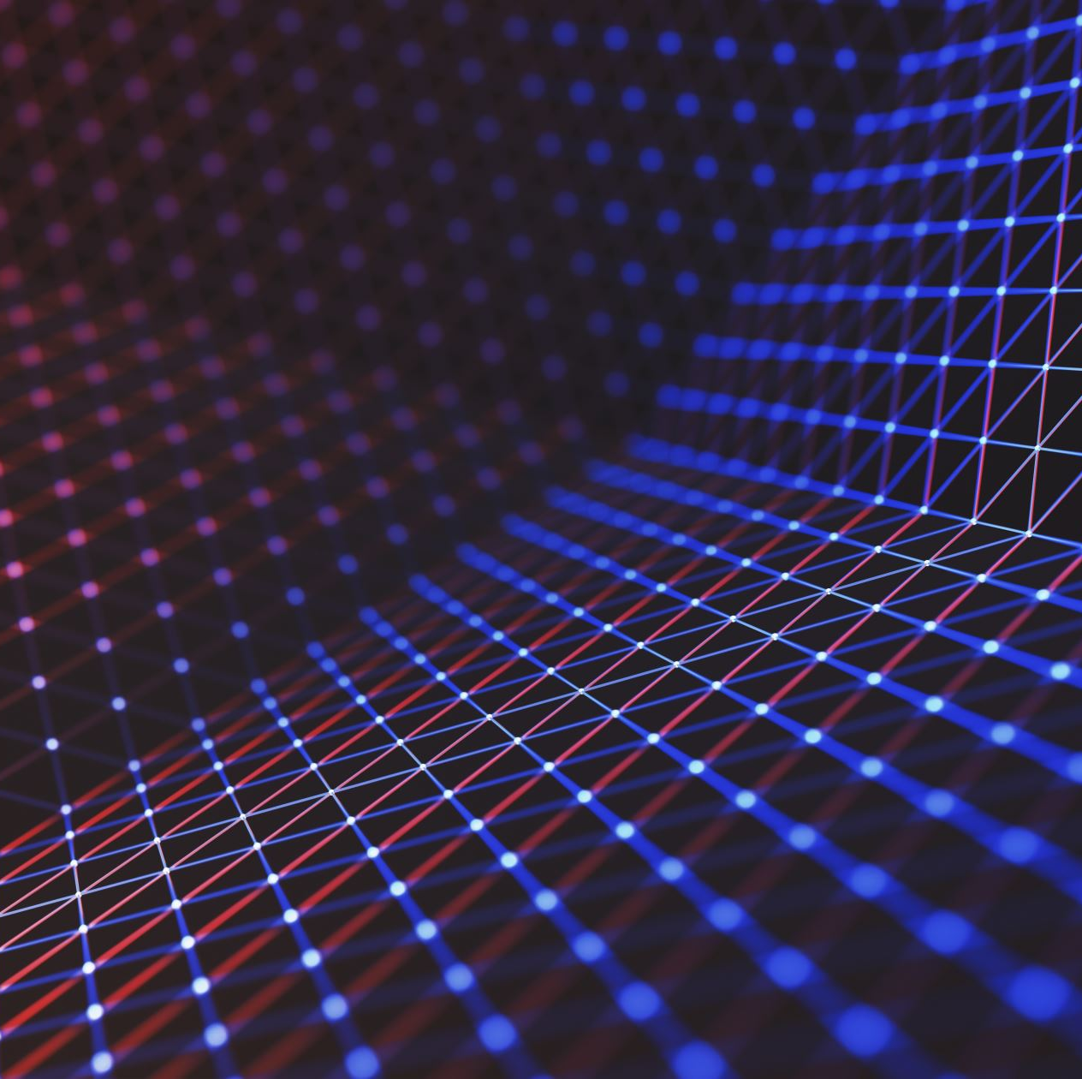
Talk Outline
QLDPC CSS Codes
Toric Code
Hypergraph Product Code
Asymptotically Good QLDPC Codes
Decoding
Bounds on QLDPC codes
Notes:
So, I'll give some brief background on QLDPC CSS(The Calderbank-Shor-Steane) codes, which is just the general framework that I'll use in this presentation to describe LDPC codes and then I'll describe the toric code before describing how it generalizes to these hypergraph product codes which, as I mentioned, are products of classical codes based on expander graphs. And then I'll describe how these codes in turn were generalized and improved to obtain these asymptotically good QLDPC codes. Then I'll turn to the computational problem of doing efficient decoding on these codes.

Slide 5
Error Correction with Quantum LDPC Codes
X –Z
< d
Encode
X –Z
Stabilizer Measurements (Low-Weight)
K
n
Message qubits (Logical)
Message
X –Z
Code q-bits (Physical)
Notes:
Error Correction with quantum LDPC code
we start with some length k message or k say logical qubits, which we encode into greater number n of physical qubits.
So if some bounded error occurs, say an error occurs on at most say d of these physical qubits, then we can perform some stabilizer measurements and recover the original message. And the key point is that these stabilizer measurements are low weight. That's the low density and low density parity check.
And we'll do these low-weight Pauli stabilizer measurements where we measure all these Pauli operators. And by doing some post-processing on these measurement outcomes, we can decode and recover the original message.
So what are the parameters that we want to optimize in this general setup, The first is the number of message qubits or the number of logical qubits.
Ideally, this number is not too much smaller than the number of physical qubits. And the ratio of k to n is known as the rate of the code and that we want to be high. It means that our encoding doesn't have too much redundancy.
We want the number of errors that we can protect against to be as large as possible.

Slide 6
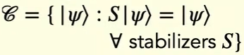
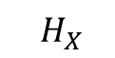
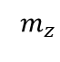
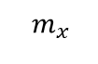
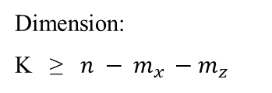
CSS Code
$${ H}_{X}$$
$${ H}_{Z}$$
X Z
X Z
X Z
X Z
Locality = 4
$${ m}_{x }$$
n
$${ m}_{z}$$
X-Stabilizers
Z-Stabilizers
Code Space:
Code qubits
Dimension:
K ≥ ${n − m}_{x }−{ m}_{z}$
Logical Operator:
Commute with stabilizers not a stabilizers
Distance:
d = min weight of logical operators (i.e. undetectable error)
Can decode from (d-1)/2 adversarial errors
${ H}_{X}$ & ${ H}_{Z}$ are check matrix and ${ H}_{Z}$.$H_{X}^{T}$ = 0 the checks of the z code are code words of the x code.
Notes:
But first I think I should give a brief description the CSS framework as this will underlie basically all the codes I'm going to talk about.
So CSS code at a high level is represented by a tripartite graph. In the middle, we have the code qubits. On the left, we have X stabilizers. And on the right, we have Z stabilizers. So each vertex on the left represents X stabilizer, And similarly, every vertex on the right, which is a Z-stabilizer, represents the tensor product of Pauli-Z's on the vertices that it's incident to.
And you can see that these two X and z-stabilizers intersect on exactly two qubits so that the two operators, the tensor product of Pauli-X's and Pauli-Z's commute And indeed, we always need our stabilizers to commute.
So any vertex on the left and any vertex on the right will have their neighborhoods intersect at an even number of positions. So the code space or the set of encoded logical states is simply the set of all states in our Hilbert space.
The dimension or the number of logical qubits that our code encodes is always at least the number of code qubits minus the number of stabilizers.
And the distance of our code is the minimum weight of a logical operator.
So the distance of this code would actually be two.
And intuitively, a logical operator, since it commutes with all the stabilizers, is a Pauli operator that we can apply without any of the stabilizer measurements detecting that we applied it. So, it's an undetectable error that our code cannot protect against.
And intuitively, we should expect the distance therefore to measure something about the minimum weight error that we cannot protect against.
So if any d minus 1 over 2 of the qubits are corrupted adversarial, we can decode and recover the original code state.
But beyond this threshold, we lose this guarantee. We may not be able to detect or correct the errors.
And finally, the locality of the code is basically the maximum degree of this tripartite graph. And it also measures the maximum weight of any of these stabilizers.
So for LDPC codes, which are the focus of this presentation, we have constant locality.

Slide 7
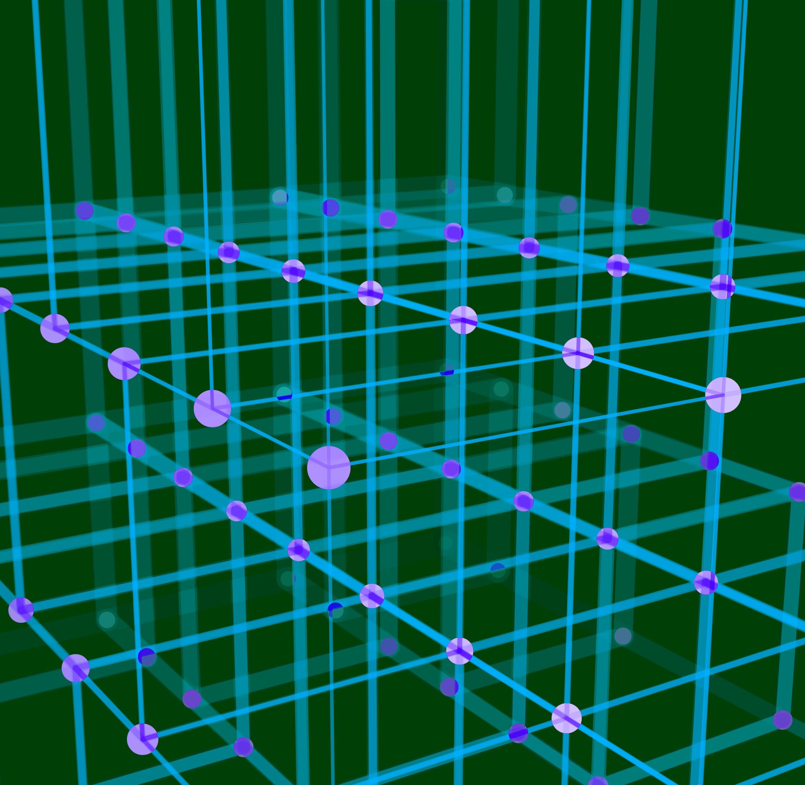
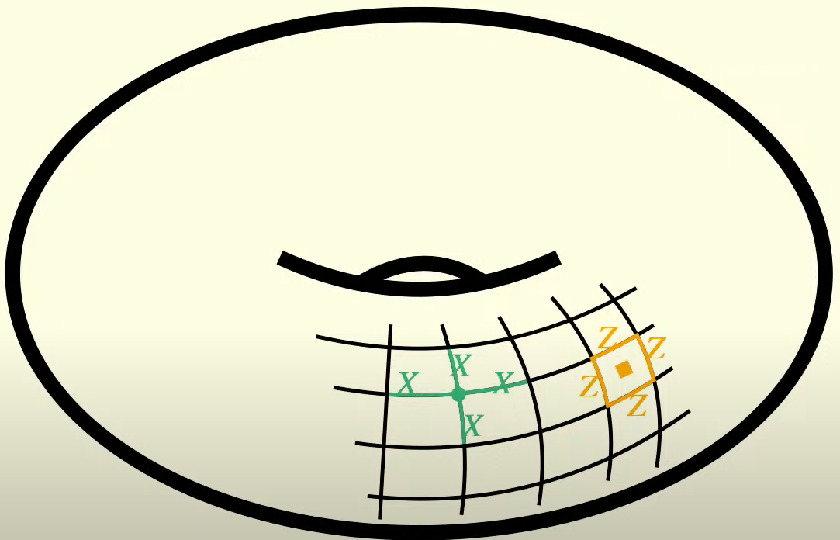
Toric Code
Edges = qubits
Vertices = X – Stabilizers
Squares = Z – Stabilizers
Locality = 4
Commute!
Notes:
TORIC code
Now, I am going to talk about the Toric code since there is a strong relationship between the Toric code and the qLDPC code.
Intuitively, the Toric code is based topologically on the torus. we want to tile the torus and to make this a discrete object that we can deal with discrete qubits on. So, we simply take a square tiling of the torus.
Here I've only drawn it on a part but we'll extend this square tiling to the entire torus.
And we place qubits of our code on the edges of this tiling.
Each edge is a qubit. At each vertex, we place an X-stabilizer, which is the product of Pauli-X's on the four qubits (edges) connected to the vertex. Thus, every X-stabilizer has a weight of four.
And the squares in the tiling are Z-stabilizers. So every square is the tensor product represents the tensor product of Pauli-Z's on the four edges of that square, all our Z-stabilizers also have weight four.
We can see that these X and Z-stabilizers commute because, for instance, the two I've drawn here don't even touch each other at all.
all of these checks are spatially local on a 2D torus.
there's two logical X and Z operators so it encodes two logical qubits since as I said the dimension depends on the number of qubits.
But on the other hand the distance is the length of the shortest cycle. And that will be almost the square root of the number of edges.

Slide 8
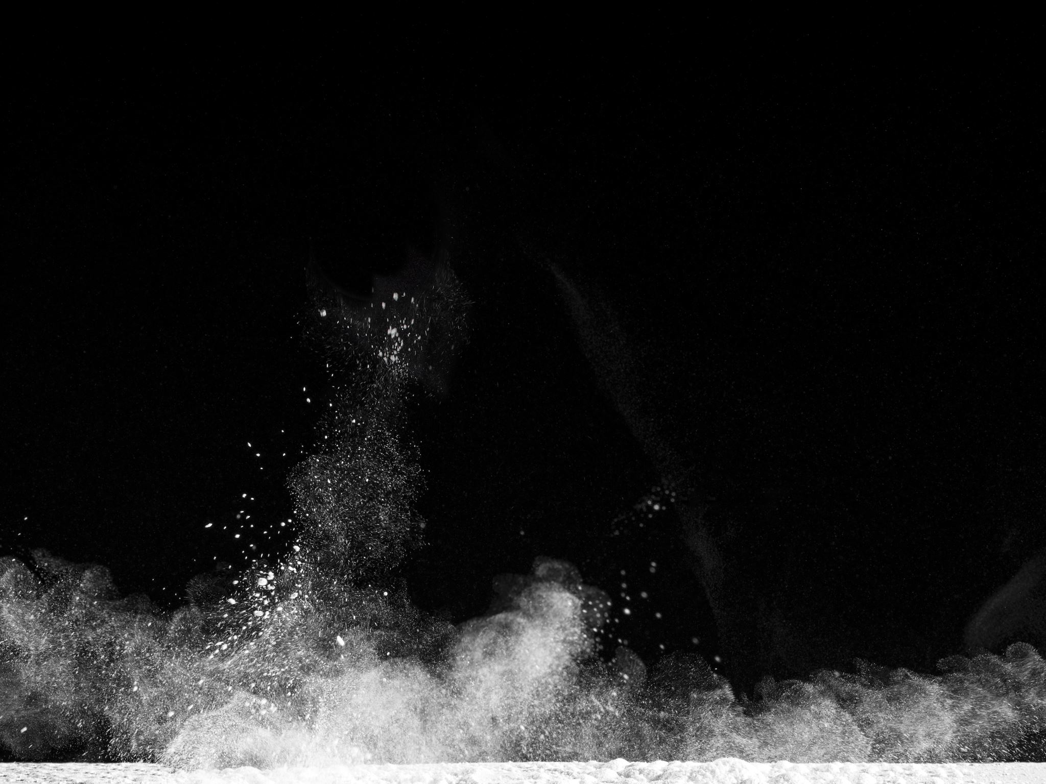
Homological form of Toric Code
a
f
d
b
c
g
Faces
c
d
b
a
f
g
Edges
Vertices
Notes:
I would have explained it as a homological code,
or as an example of a homological code.
So we have these two sides identified, and these two sides identified. And we have our checks.
So we have our checks associated to the vertices.
And we have our qubits living on the edges.
.
Now the only thing is important here is the incidence relationship, like which edge belongs to which vertex and which edge belongs to which face. So I can write this abstractly as a partially ordered set, where I put my faces here. And I put the nodes for each face. And I have my edges here. I'm going to put nodes for each edge,
and I put my vertices here.
But now you see this poset, this incidence relationship between faces, edges, and vertices is exactly the Tanner graph.

Slide 9





Product Construction
Edges
Vertices
=
Toric
$$×$$
$$×$$
=
Faces
$$H_{Z }$$
$$×$$
Edge
=
$$H_{X }$$
$$×$$
=
Edge
$$×$$
=
Vertices
Notes:
So now I want to talk about the more successful approach
in increasing the distance. And these are product constructions.
And for this, let me consider the repetition code.
I have an edge on the bits. And each bit is checked by two checks.
Now, the thing I want to speak about it is, in some sense, a classical code is a one-dimensional object. Because we have these two layers. We have vertices and we have edges, but we have nothing higher, which we need to define our CSS construction. So the question is, how do I take something which is classical, like one-dimensional, and turn it into something which is higher dimensional, which is quantum?
if I take the product of two edges-- get a square face.
Now, the edges in here are products between an edge and the vertex, or a vertex and an edge, and vertices, the products between two vertices.
we use this to define our code. So we get our Hz and our Hx. I took two repetition codes, and I defined the toric code from these two repetition codes.
So the toric code, in some sense, is like the quantum version of the repetition code.

Slide 10
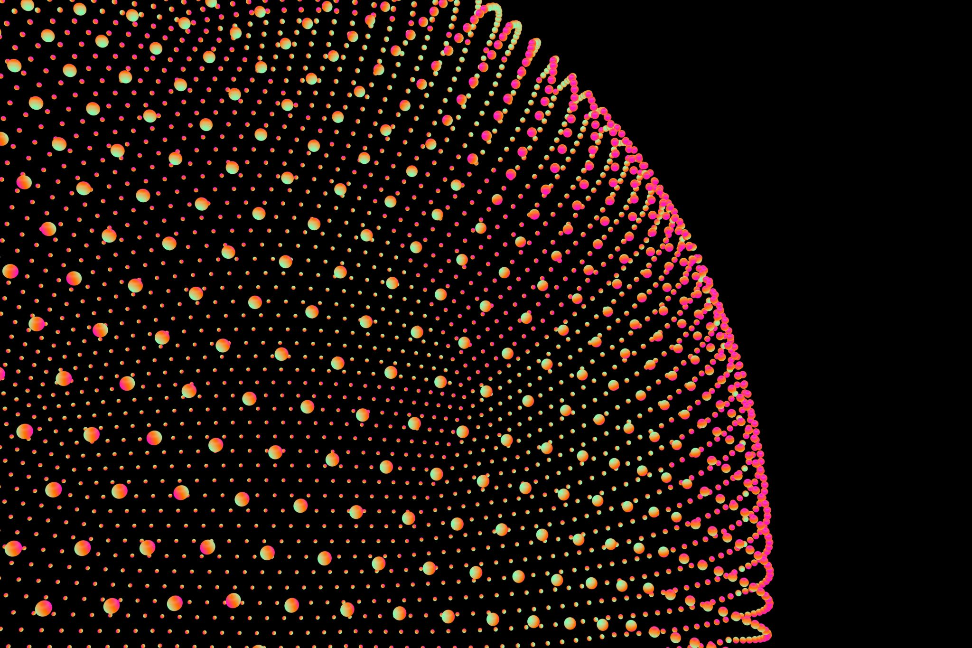
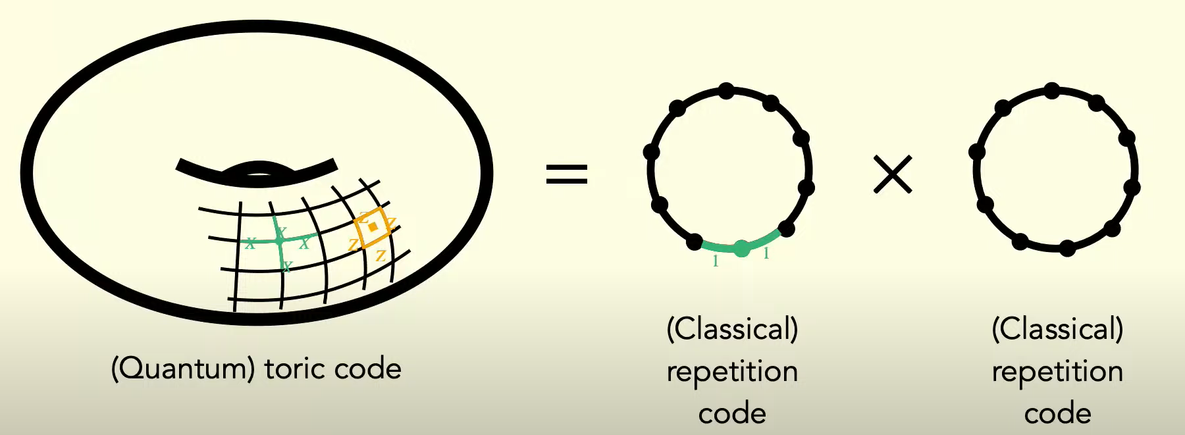
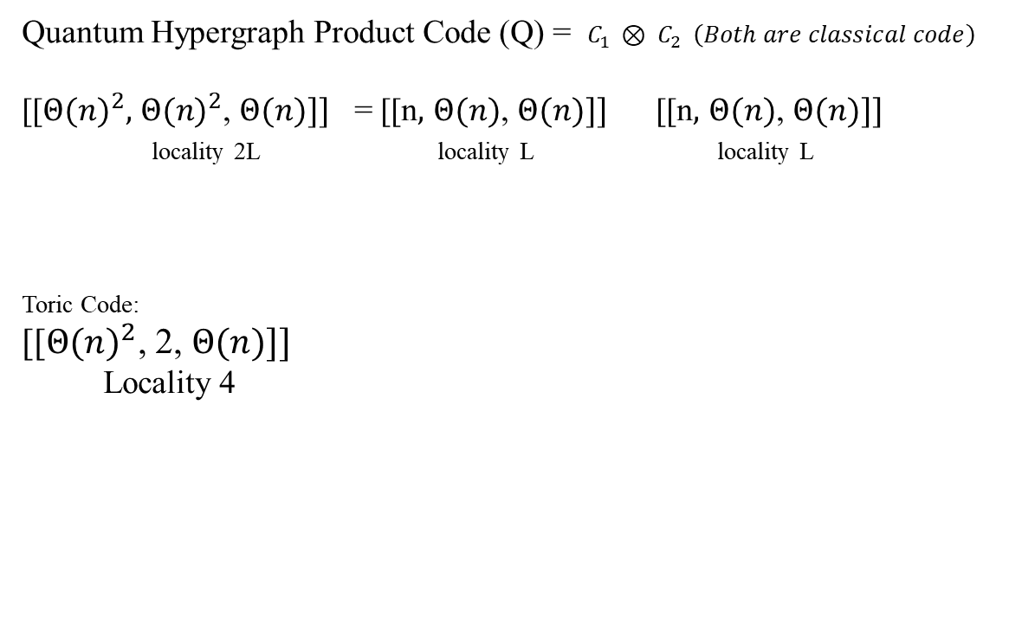
Product Codes
Quantum Hypergraph Product Code (Q) = $C_{1 }⊗ C_{2 } \left(Both are classical code\right)$
[[$Θ{(n)}^{2},$ $Θ{(n)}^{2}$, $Θ(n)]]$ = [[n$,$ $Θ(n)$, $Θ(n)]]$ [[n$,$ $Θ(n)$, $Θ(n)]]$
locality 2L locality L locality L
Toric Code:
[[$Θ{(n)}^{2}$, 2, $Θ(n)]]$
Locality 4
Notes:
And indeed, we can actually take products like this for arbitrary classical codes.
So we have a classical code C1, another classical code C2, and we can take their product, in particular the hypergraph product. And we'll get some quantum code Q.
And what's interesting is that if these classical codes are asymptotically good, so their dimension and distance grow linearly with the number of bits and say they're LDPC classical codes so they have constant locality.
So in terms of dimension, in terms of logical qubits, we're doing much better than the toric code. In terms of distance, we're still matching the Toric code. So we're going to need to find a way of constructing this hypergraph product code from two classical codes.
I'll first just give some background on classical codes. And we can describe this classical linear code via something called a Tanner graph.
And the distance of a classical code is, again, the minimum weight of any nonzero code word.
The dimension or the number of logical bits classically is always at least n minus r, the number of code bits minus the number of parity checks.

Slide 11
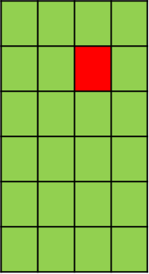
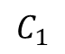
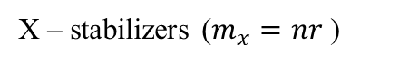
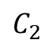
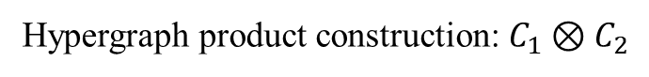
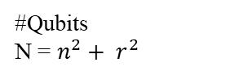
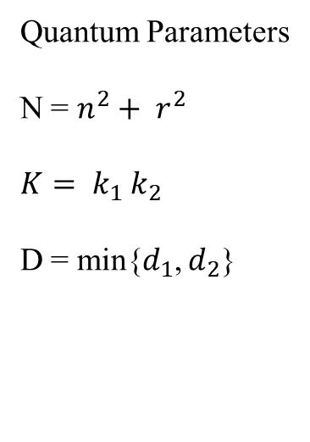
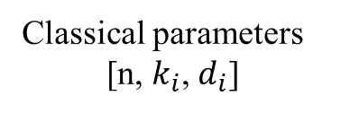
Hypergraph product construction: $C_{1}⊗C_{2}$
r
$$C_{2}$$
n
1 | 1 | 0 | 0 | 1 | 1
X – stabilizers ($m_{x}=nr$)
Stabilizers Commute!
Classical parameters
[n, $k_{i}$, $d_{i}$]
 | X |  | Z-X |  | X
 |  |  | Z
 |  |  | Z
Z | Z |  |  | Z | Z
 | X |  | X |  | X
 |  |  | Z
 |  |  | Z
 |  |  | Z
Z | Z |  |  | Z | Z
n
Quantum Parameters
N = $n^{2}+ r^{2}$
${K= k}_{1}$ $k_{2}$
D = min{$d_{1}$, $d_{2}$}
$$C_{1}$$
#Qubits
N = $n^{2}+ r^{2}$
Z – stabilizers ($m_{z}=rn$)
 |  | X
Z |  | Z-X
Z |  | Z
 |  | X
 |  | X
r
Notes:
I'll now just go back to this hypergraph product construction
where we now have two classical codes and we want to construct a quantum code. And you might see the terminology like product of chain complexes.
Let's consider two classical codes, C1 and C2, each represented by a Tanner graph. These graphs illustrate the relationships between bits and checks within each code. Now, for our hypergraph product code, we'll construct qubits arranged in two grids. This setup gives us a total of n² + r² qubits for our quantum code.
We have an n by r grid of X-stabilizers and an r by n grid of Z- stabilizers.
So in total, we have 2nr stabilizers.
Now, I just need to specify what connections exist in this quantum Tanner graph. Specifically, I'll define which edges connect to each vertex or what stabilizer each vertex represents.
First, from this vertex, we can move left to the corresponding vertex in C1's Tanner graph and then move up to the corresponding vertex in C2's Tanner graph.
Starting from a vertex in each of the classical Tanner graphs (C1 and C2), we can examine the neighboring vertices connected to them. This results in two sets of vertices: one set from the neighborhood of the vertex in C1 and another set from the neighborhood of the vertex in C2.
We take the neighborhood from down here and move it into the column where we began. Similarly, we take the vertices from our classical graph in C2 and slide them into the row where we started. And you can see now we have a subset of the qubits.
We define this stabilizer as the product of Pauli-X operations on all the qubits we've reached. This means multiplying the Pauli-X operations of qubits from both the row and the column where we began.
And you can see this ends up being like a weight five X-stabilizer.
Now we can do the same thing for Z-stabilizers. So, say we choose this vertex down here.
And we want to know what the Z-stabilizer represents.
We travel left and up to get to vertices in the classical Tanner graphs, pass to their neighborhoods to get a set of vertices in each classical Tanner graph, and again, drag this set down into the row and into the column that we started in. And we end up with a tensor product of Pauli-Z's on five qubits in our hypergraph product. So, this is a Z-stabilizer.
The X and Z-stabilizers we're examining intersect at exactly two qubits, showing they commute. This is always true because if these stabilizers intersect at one point, we can complete a rectangle with the two vertices where we started, guaranteeing another intersection elsewhere.
In this construction, stabilizers always intersect at zero or two qubits so they all commute.
And now I want to describe how we can obtain logical operators in the hypergraph product from classical codewords.
It turns out that if we have a classical codeword, say in C2-- say it's 110011, then we'll get a logical operator in the hypergraph product code by dragging this codeword down into one of the rows of this grid and placing Pauli-Z's where we had ones.
So the tensor product of these four Pauli-Z's is a logical operator.
And this will happen where we could actually get a similar thing but a different logical operator by just putting the same classical codeword in a different row of this grid.
So basically, by putting the classical codeword in different rows of this grid of qubits, we can get different logical operators.
So the classical parameters of these classical codes should say something about the quantum parameters of this quantum code.
And indeed, we see that at least maybe the distance is easier to see since classical codewords seem to lift directly to quantum codewords.
Under some assumptions on the classical Tanner graphs, it will always hold that the distance of the quantum code or the minimum weight of a quantum logical operator is the minimum of the distances of the two classical codes.
that the dimension of the quantum hypergraph product code is the product of the dimensions of the two classical codes.

Slide 12
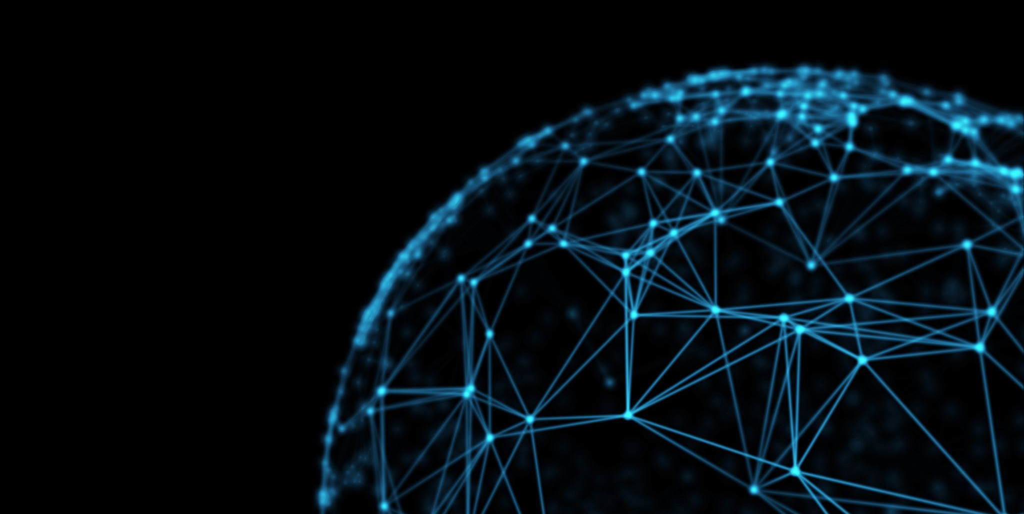
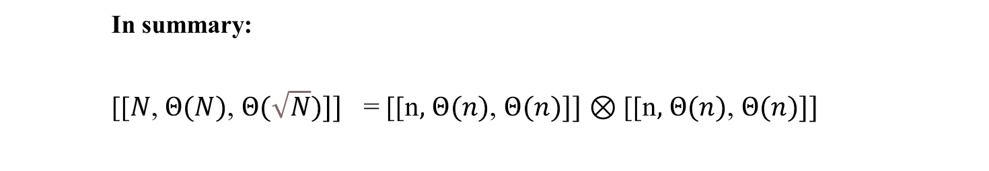
Improving the Hypergraph product
How to further improve distance?
Introduce a “Twist” in our notation of product
In summary:
[[$N$, $Θ(N)$, $Θ(\sqrt{N})]]$ = [[n$,$ $Θ(n)$, $Θ(n)]]$ $⊗$ [[n$,$ $Θ(n)$, $Θ(n)]]$
Notes:
The product of two classical good LDPC codes is a quantum LDPC code with dimension growing linearly in the number of qubits but distance growing as the square root of the number of qubits.
And it's natural to ask how we can further improve the distance of this code because this square root n is still the same as the toric code of the constants.

Slide 13
Putting a twist in the Toric Code
Recall: Code distance = Length of shortest cycle
Observation:
Cycle length increases if we cut, open and twist torus!
Notes:
So now I'll briefly describe how we can go from this construction to asymptotically good QLDPC codes.
As I said, the distance of this code is the length of the shortest cycle.
Then it turns out that the cycle length will increase if we cut open and twist the torus.
We’ve cut it and open so it's now a pipe and to reconnect up this and make it a closed cycle again, we have to add in an additional segment to connect the two ends and this will actually increase the length of the cycle because we have to add this additional segment, this orange segment here and so the cycle length increases. And that means that the distance of this code increases once we've twisted it.

Slide 14
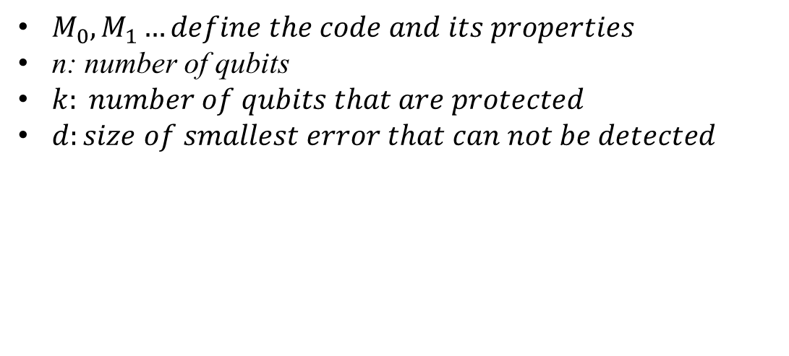


How do stabilizer codes work?
$M_{0},M_{1}…define the code and its properties$
n: number of qubits
$k: number of qubits that are protected$
$d:size of smallest error that can not be detected$
Notes:
before talking about the bounds, I'm going to talk about what are stabilizer codes?
Imagine you have a bunch of qubits, and one of these qubits might be corrupted by an error here in black.
And one thing that can quite naturally do is you're going to perform some measurements on your qubits in the hope that one of these measurements is going to identify this error.
So these measurements are going to define both your code and its properties.
We're interested in, mainly, three properties:
n: the number of qubits that you have in your system;
k, the number of qubits that are protected by the noise; and
d is the size of the smallest error that you cannot detect.

Slide 15















How do stabilizer codes work?
Different measurements different connectivity structure
Codes live might live in different dimensions
$$\overline{Z}$$
$$\overline{Z}$$
Notes:
Given that different codes are going to involve different measurements, you're going to end up with different connectivity structures with your qubits. So like, here, for example, you have the very famous 2D surface code.
And here, you have the also famous 3D code. And these different dimensions are directly related to the fact that the logical operators are also going to change shifts.
it's like the famous string operators for the 2D surface code and the 3D code is going to have a different structure.

Slide 16
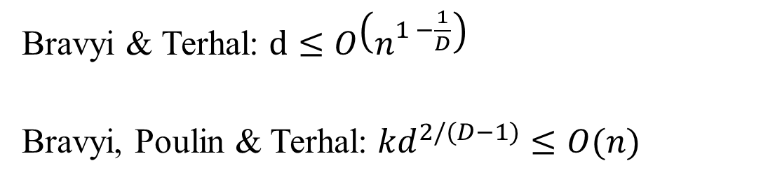
BPT Bounds
Codes in low dimensions perform poorly
Bravyi & Terhal: $d≤O\left(n^{1 −\frac{1}{D}}\right)$
Bravyi, Poulin & Terhal: ${kd}^{2/(D−1)}≤O(n)$
Notes:
Now, unfortunately, these codes, in low dimensions, they don't perform very well. We have bounds called the Bravyi-Poulin-Terhal bounds that you're seeing these equations in their full generality, The point is mostly that you have a bound on the distance that gets less restrictive as the dimension, d, increases. And similarly, you have a trade off between k and d that gets less restrictive as the dimension d increases as well.

Slide 17
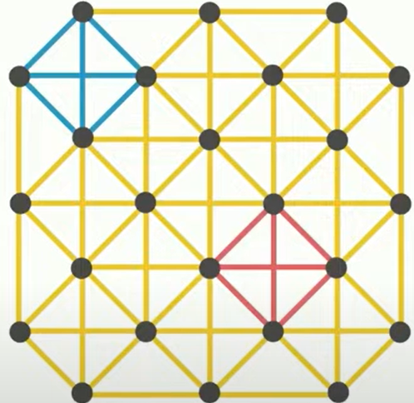
Connectivity Graph
Z
X
Notes:
I'm going to need to introduce a graph associated to a code. And the kind of graph that we're going to use is called the connectivity graph. This is the surface code, and this is the associated connectivity graph.
You have one node per qubit, and you have an edge between two nodes, if they are involved in the same measurements

Slide 18






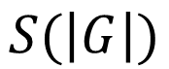



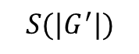







Quantify Connectivity
Some graphs have a particularly uniform structures
Called S-Separable
$$S(\left|G\right|)$$
$${S(|G}^{′}|)$$
Notes:
So some graphs have a particularly uniform structure. What I mean by that is if you look at a 2D lattice, you can remove, essentially, the square root of n vertices and separate it into two parts that are approximately equal.
If I zoomed in into one and another area, then I would have the same property, where I can remove square root of n vertices to separate it into two approximately equally-sized regions, and I can do that again and again and again.
And this property of these graphs is called being separable, where s is the function that tells you how many vertices you need to remove in function of the size of the graph.
So, for example, in the case of a 2D lattice, the function s would be square root of the size of the subgraph.

Slide 19
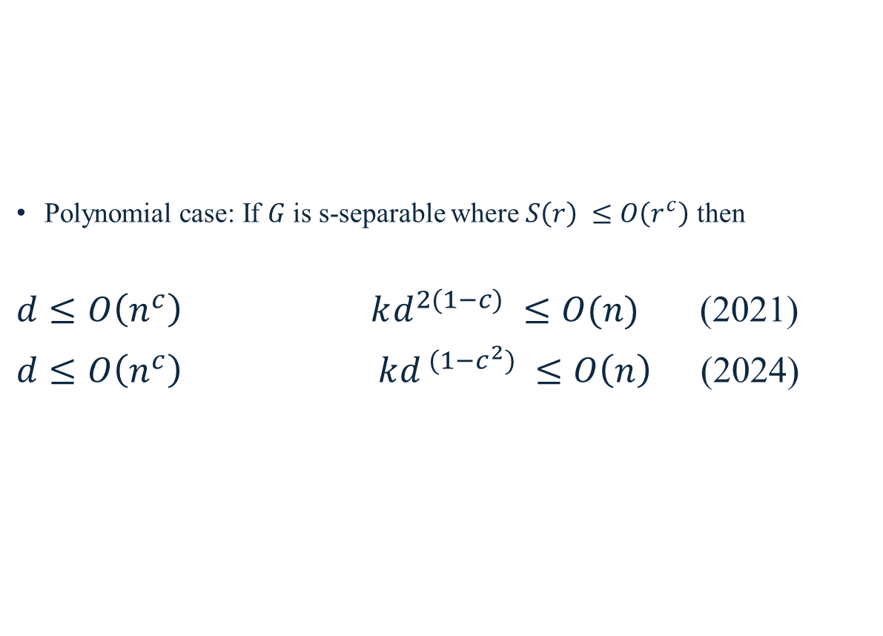
Bounds from connectivity
Polynomial case: If $G$ is s-separable where $S\left(r\right) ≤O\left(r^{c}\right)$ then
$d≤O\left(n^{c}\right)$ $kd^{2(1−c)} ≤O(n)$ (2021)
$d≤O\left(n^{c}\right)$ $kd^{ (1−c^{2})} ≤O\left(n\right)$ (2024)
Notes:
All right, we're going to be particularly interested in cases where the function s is a polynomial. so you can bound it by a polynomial. and there has been a series of results using this metric. The first one was in 2021, and we obtained this bound on the distance and similarly, a tradeoff between k and d.

Slide 20
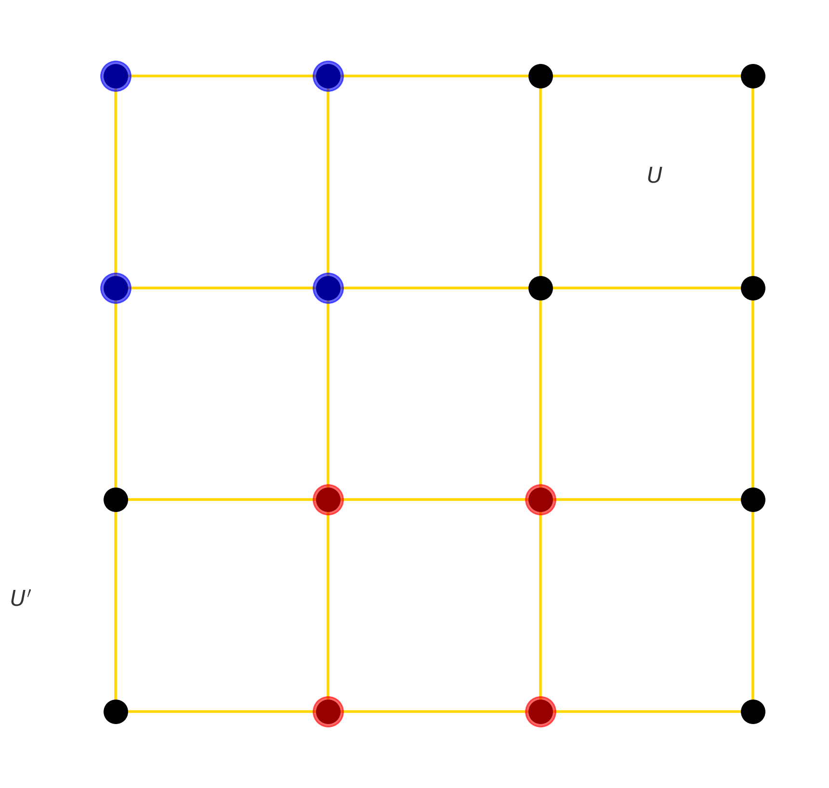


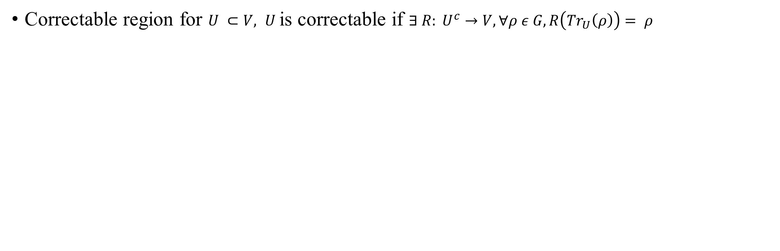



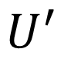


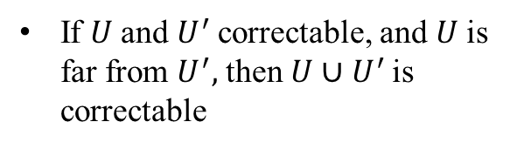


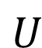
Toolkit: correctable regions
Correctable region for $U ⊂V, U$is correctable if $∃ R: U^{c}→V, ∀ρ ε G, R\left({Tr}_{U}\left(ρ\right)\right)= ρ$
If $U$and $U^{′}$correctable, and $U$is far from $U^{′},$ then $U∪$ $U^{′}$ is correctable
$$U^{′}$$
$$U$$
Notes:
Toolkit
And I'm going to try to explain to you how we got to these bounds. So the first notion that I'm going to use is that of a correctable region.
Imagine that you have your bunch of qubits, and you lose a set U of your qubits. This set is said to be correctable if there is a recovery operation R such that even if I'm left with everything that wasn't in U,
I can recover the original state that I had before I lost my qubits.
Something that's quite interesting about a correctable region is that I can actually compose them.
So, out of smaller correctable regions, I can make bigger ones. The first lemma that we're going to use is the correct union lemma.
It says that if I have two regions it's like, you have U and U prime, and if they're far enough from each other, namely if they are disjoint in the graph, and each region is correctable, then the union is correctable.

Slide 21

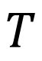




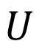









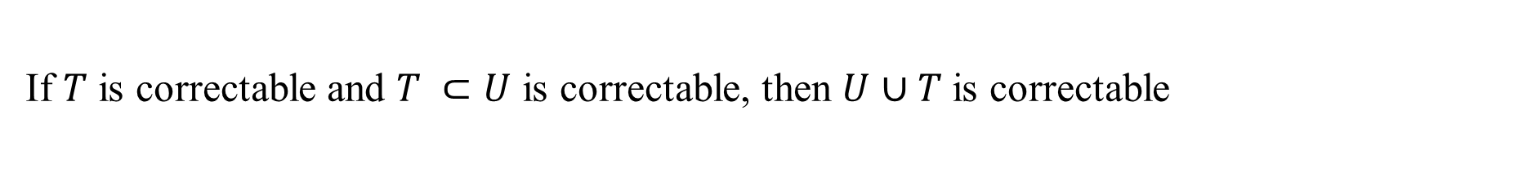
If $T$ is correctable and $T ⊂U$ is correctable, then $U$ $∪T$is correctable
Toolkit: correctable regions
$$U$$
$$T$$
Notes:
The second lemma we're going to use is kind of a complement of that.
It says that if you have a region T that is correctable, and then you have a region U, that contains the boundary of T. So the boundary is the set of all nodes that have an edge going into T.
So if U contains the boundary of T, and U is also correctable, then T and U is correctable simultaneously.

Slide 22
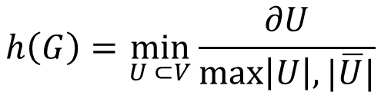
Graph Expansion
$$h\left(G\right)=\min_{U ⊂V}{\frac{∂U}{\max\left|U\right|,|\overline{U}|}}$$
$G is said to be ε−expander if h\left(G\right)≥$ $ε$
Notes:
There is limitation to detect each regions. But, What can we do? Use graph expansion
We have some ideas about how to use a different metric that actually recover BPT while remaining geometry oblivious. the idea is, in a graph, you can look at how big the boundary is.
If you look at a region U here, you can look at how big this boundary is
relative to the size of the region U.
So here, it's calculated by the ratio of the boundary of U over its size, and we want to capture how well-connected the graph is, so we're going to minimize over all the sets U. And G is said to be epsilon-expander if this metric is bigger than epsilon.

Slide 23
Graph expansion
Converse to separation profile
Has a small separator
No small separator exist
Notes:
And the way I think about it is that the expansion is kind of a converse to the separation profile.
So, for example, if I look at this graph here, what the separation profile tells me is that this graph is easily separable.
I can remove this vertex here, and then I have two subgraphs of equal size. The expansion tells me the opposite.
It tells me that if I look at a graph, then there is no way for me to separate it easily.

Slide 24
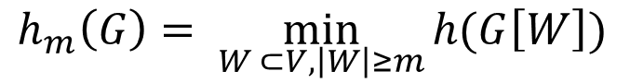
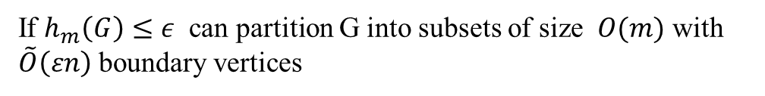
Graph expansion VS partitioning
$$h_{m}\left(G\right)= \min_{W ⊂V, \left|W\right|≥m}{h(G\left[W\right])}$$
If $h_{m}\left(G\right)$ is small poorly connected cluster of size < m
If $h_{m}\left(G\right)≤ε$ can partition G into subsets of size $O(m)$ with $\tilde{O}\left(εn\right)$ boundary vertices
Notes:
So I want to look at all the subgraphs of size at least m, and I want to calculate how expanding that subgraph is.
Once I know that, imagine that I have a graph here such that this quantity is small for a certain m.
It kind of means that this graph is made up of a bunch of bundles of size m, but the connection between these bundles is kind of bad.
What I can do now is, quite naturally, separate it into these little clusters, and then I get a nice partitioning.
So you can do some graph theory stuff and eventually get that if this quantity is by that quantity, then you get a separation of your graph such that-- into regions of size m by using at most epsilon n vertices.
So at the boundaries there, you have, at most, epsilon and vertices.

Slide 25
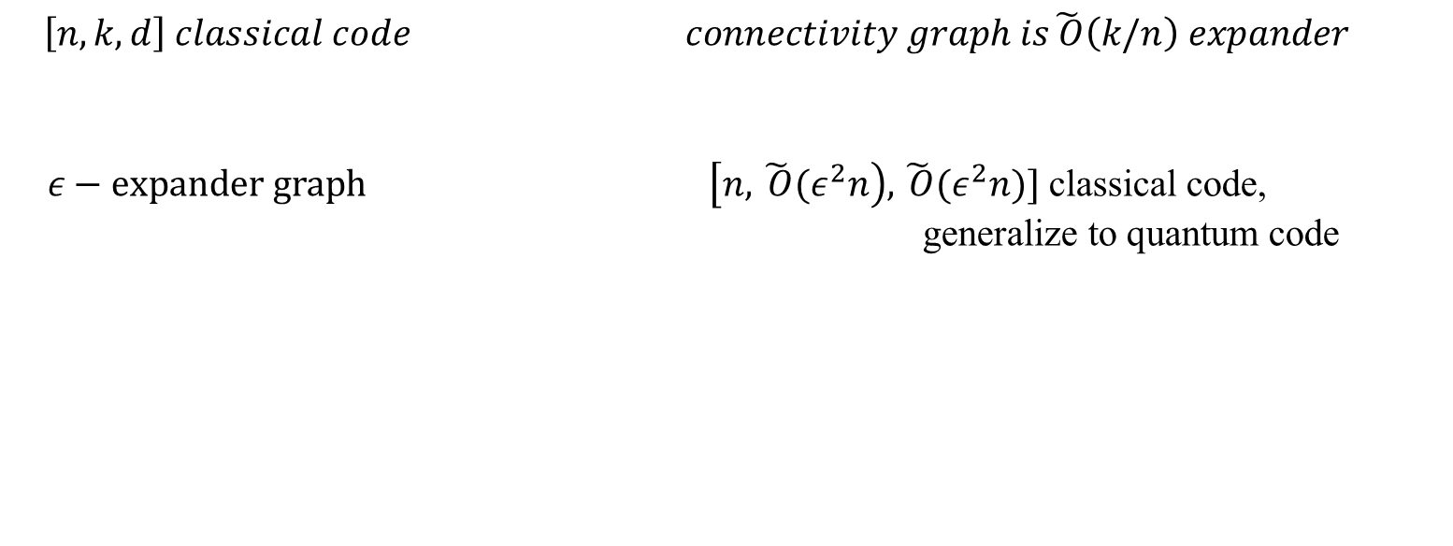
Graph Expansion Bounds: Converses(!)
$$\left[n,k,d\right] classical code connectivity graph is\tilde{ O}\left(k/n\right) expander$$
$ε−expander graph$ $\left[n, \tilde{ O}{(ε}^{2}n\right), \tilde{ O}{(ε}^{2}n)]$ classical code, generalize to quantum code
Notes:
And so we have results that show that this holds in the case of classical codes. I can tell you that its connectivity graph has to contain some amount of expansion.
And conversely, if you give me an expanded graph, then I can show you that I can embed a classical code with these parameters in this connectivity graph.
The target that we would like is to have a better encoding rate and a better distance, but it's quite notable that we can take an arbitrary architecture and then have some kind of guarantee on the codes that we can embed.
To my knowledge, this is the first kind of-- the first result of this kind, and it would be really interesting to know if this can be expanded to quantum codes

Slide 26
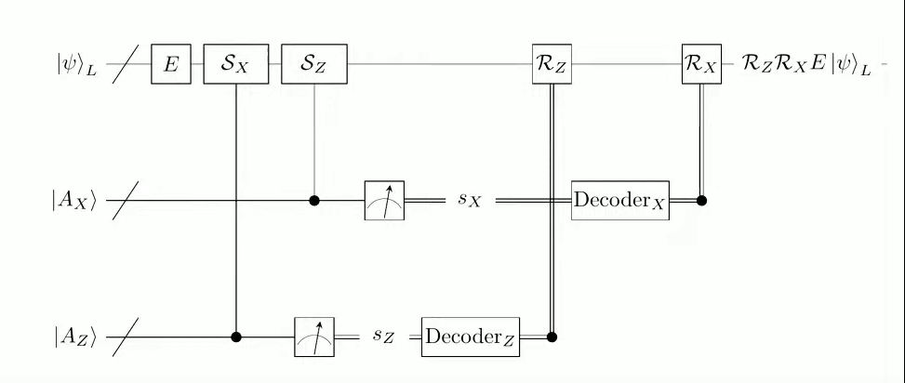
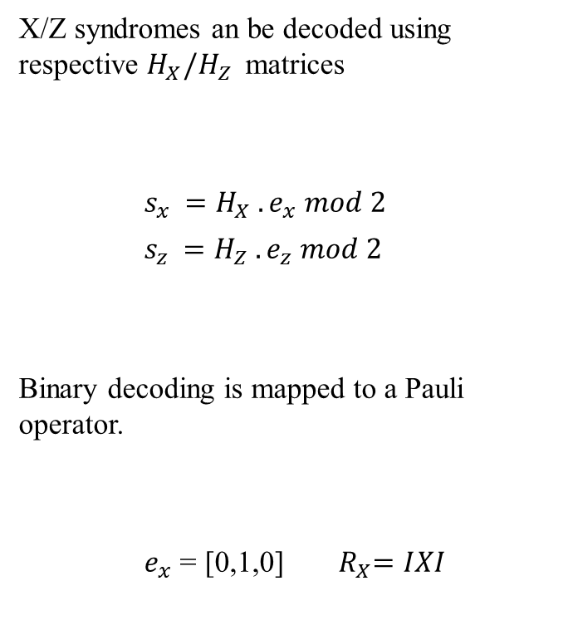
Decoding Quantum LDPC Code
X/Z syndromes an be decoded using respective $H_{X}/H_{Z }$ matrices
$s_{x }=H_{X} .e_{x} mod 2$
$s_{z }=H_{Z} .e_{z} mod 2$
Binary decoding is mapped to a Pauli operator.
$e_{x}$= [0,1,0] ${ R}_{X}=IXI$
The decoding cycle for a quantum LDPC code.
The two error types X/Z can be decoded separately as two independent classical codes.
Notes:
it's always useful to study the decoding problem in the simplest possible error model.
We call this the code capacity error model. In the code capacity error model,
we just assume that errors occur just before we measure the stabilizers.
OK? And because we're measuring the x and the z stabilizer separately, we have two separate decoding problems.
So we get our x and our z syndrome, and then we use the respective Hz and Hx CSS
matrices to decode these as two independent, classical decoding problems.
And what we get out from this is some sort of binary vector that we then map to a recovery operation which is then applied to the quantum state.

Slide 27
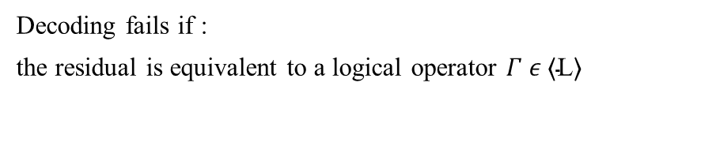
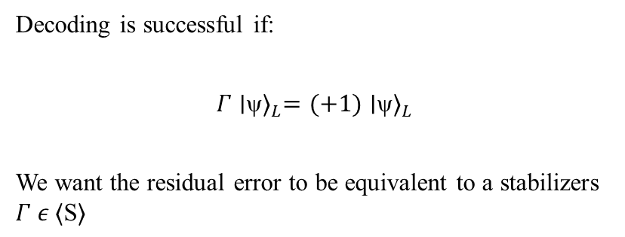
Decoding Success
In simulation, How do we determine whether our decoding was successful?
The CSS decoders return two recovery operation: ${ R}_{X}$ and $R_{Z}$
Residual error: $Γ= { R}_{X}R_{Z} E, where E is the actual error$
Decoding is successful if:
$$Γ{\text{∣}\text{ψ}\text{⟩}}_{L}=(+1){\text{∣}\text{ψ}\text{⟩}}_{L}$$
We want the residual error to be equivalent to a stabilizers $Γ$ $ε \text{⟨}\text{S}\text{⟩}$
Decoding fails if :
the residual is equivalent to a logical operator $Γ$ $ε \text{⟨}\text{L}\text{⟩}$
Notes:
So given this process, how do we actually determine our decoding has been successful.
Well, in simulation what we can do is we can calculate what we call the residual error.
So our CSS decoder will return two Pauli operations, Pauli operation to correct x errors and one to correct z errors. And the residual error is just the combined effect of these recovery operations and the actual error.
If we're doing a simulation, we know exactly what that is.
And we say that decoding is successful if the action of this residual error
is to map onto the plus 1 eigenspace of the logical states.
So this is the same as saying that the residual error is equivalent to a stabilizer.
And conversely, decoding fails, if the residual error is equivalent to a logical operator
such that this logical state, the information encoded there has changed, so our error correction protocol has failed

Slide 28

Thank you for your attention

